Slide 1

ELECTRICAL AND ELECTRONICS ENGINEERING & USER INTERFACE
Photovoltaic Supplied DC Motor Fed from DC-DC Converter And Controlled by Neural Networks
GROUP-12

Slide 2
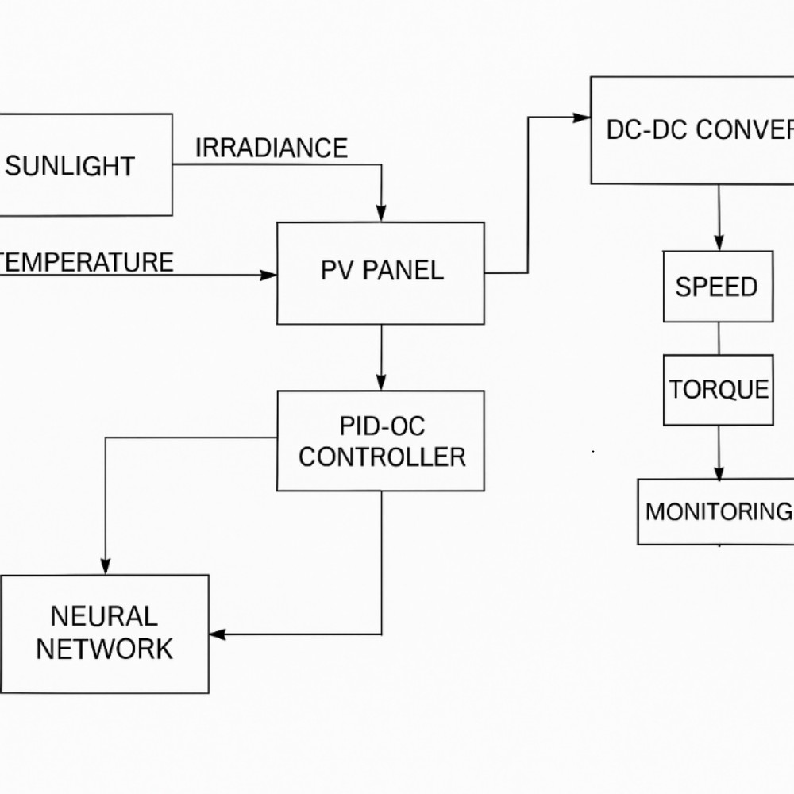
REFERANCE DIAGRAM

Slide 3
TEAM MEMBERS
1.AADHIJITH - CB.SC.U4AIE24113
2.KAMALESH - CB.SC.U4AIE24121
3.SIVA ADITHYA - CB.SC.U4AIE24126
4.SIDDHARTH SANKER - CB.SC.U4AIE24151

Slide 4
INTRODUCTION
DC-DC converters are used to regulate and adjust the voltage from the PV panel.
A DC motor is powered using the regulated output from the converter.
To maintain stable performance, the system needs an intelligent controller.
We use Neural Networks for controlling the converter due to their adaptive learning capabilities.
The entire system is modeled and simulated using MATLAB Simulink for analysis and validation
Photovoltaic (PV) systems convert solar energy into DC power, but their output is variable.

Slide 5
ObJective
To implement a DC-DC boost converter for voltage regulation.
To design and integrate a neural network controller for intelligent power management.
To ensure maximum power extraction from the PV array under varying sunlight conditions.
To achieve stable and efficient operation of the DC motor using smart control.
To model a solar photovoltaic (PV) system supplying a DC motor load.

Slide 6
METHODOLOGY
1. Photovoltaic (PV) Array Modeling
Modeled using PV Array block from Simscape.
Inputs: Solar irradiance and temperature.
Output: DC voltage and current to power the system.
Simulates real-time behavior of a solar panel under changing sunlight conditions.
2. DC-DC Converter (Boost Converter)
A boost converter steps up the PV voltage to match motor requirements.
Composed of inductor, and capacitor.
Regulated by a control signal from the neural network.
Ensures optimal voltage is supplied to the motor.

Slide 7
.
3. Neural Network Controller
Replaces traditional MPPT or PID methods with AI-based control.
Trained to:
Monitor PV output.
Predict optimal duty cycle or voltage level.
Input features: PV voltage, current, irradiance.
Output: Control signal for the DC-DC converter.
Improves response under variable environmental conditions.
4. DC Motor Load Modeling
Parameters include:
Armature resistance and inductance
Torque constant and inertia
Outputs:
Motor speed
Torque
Armature current
A separately excited DC motor is used to simulate mechanical load (e.g., a pump or drive).

Slide 8
5. Control and Monitoring System
Neural network output is applied to control the boost converter.
Scopes are used to observe:
Motor speed and torque
PV power and voltage
Neural network prediction performance
6. Simulation Configuration
Simulation run in continuous time using powergui.
Variable solar conditions tested using step or ramp inputs for irradiance

Slide 9
Problem Statement
PV systems suffer from power fluctuations due to changing sunlight.
DC motors require stable voltage, which is affected by PV output.
Traditional control methods can't adapt well to dynamic conditions.
There's a need for a smart controller to ensure efficient power flow.
Neural networks offer a solution for real-time, adaptive control

Slide 10
Research Gap
Most PV systems still use basic MPPT or PID controllers with limited adaptability.
Neural networks are rarely applied for direct control of DC-DC converters in PV-fed motor systems.
Existing studies often focus on either MPPT or motor control, not their combined integration.
There's a lack of Simulink-based models demonstrating full system control using AI

Slide 11
Conclusion
A Simulink model was developed for a PV-supplied DC motor system.
A neural network controller was used for smart control of the DC-DC converter.
The system achieved efficient power transfer and stable motor performance under variable conditions.
This approach shows that AI-based control can improve the reliability and efficiency of renewable energy applications.

Slide 12
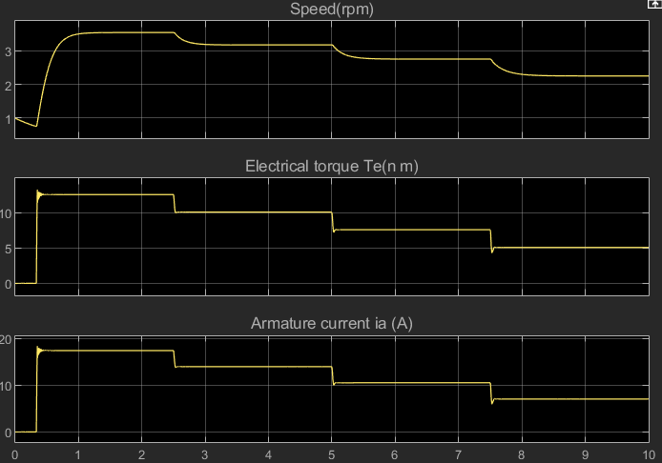
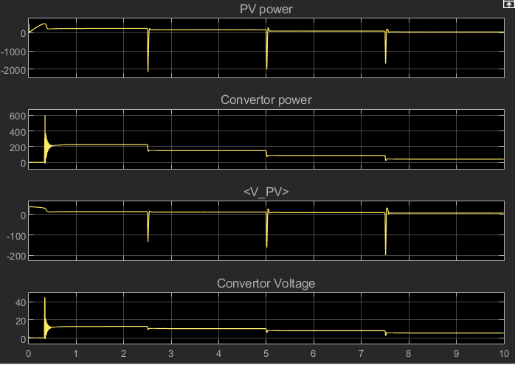
Results

Slide 13
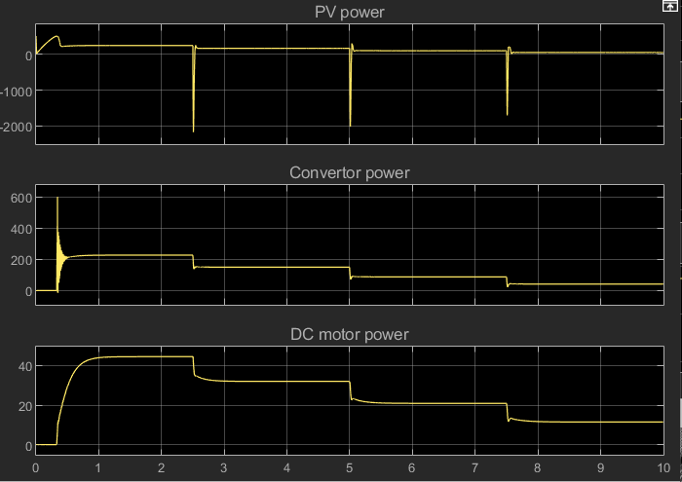

Slide 14
THANK YOU!

